Slide 1
Digital Marketing Frameworks
L04

Slide 2
What is it?
It is a model that defines marketing processes and workflows and outlines crucial components and touchpoints in the buyer journey
It is like a compass guiding you towards your marketing goals
Brings structure to the digital marketing process
Marketers can save time by modeling their frameworks from existing frameworks
Ensures a 360 perspective and nothing gets lost in action.

Slide 3
Why Use Digital Marketing Frameworks?
Digital marketing strategy frameworks help marketers:
Develop successful digital marketing plans by identifying critical actions for each stage of the customer journey
Identify roadblocks to conversions by analyzing the entire customer journey and past marketing performance
Recognize opportunities to drive customers towards the desired action
Avoid gaps in hand-offs by creating harmony between collaborating teams
Create a smooth experience and minimize friction at every customer touchpoint

Slide 4
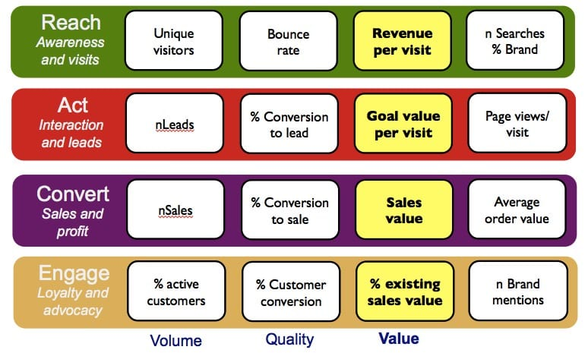
RACE Framework

Slide 5
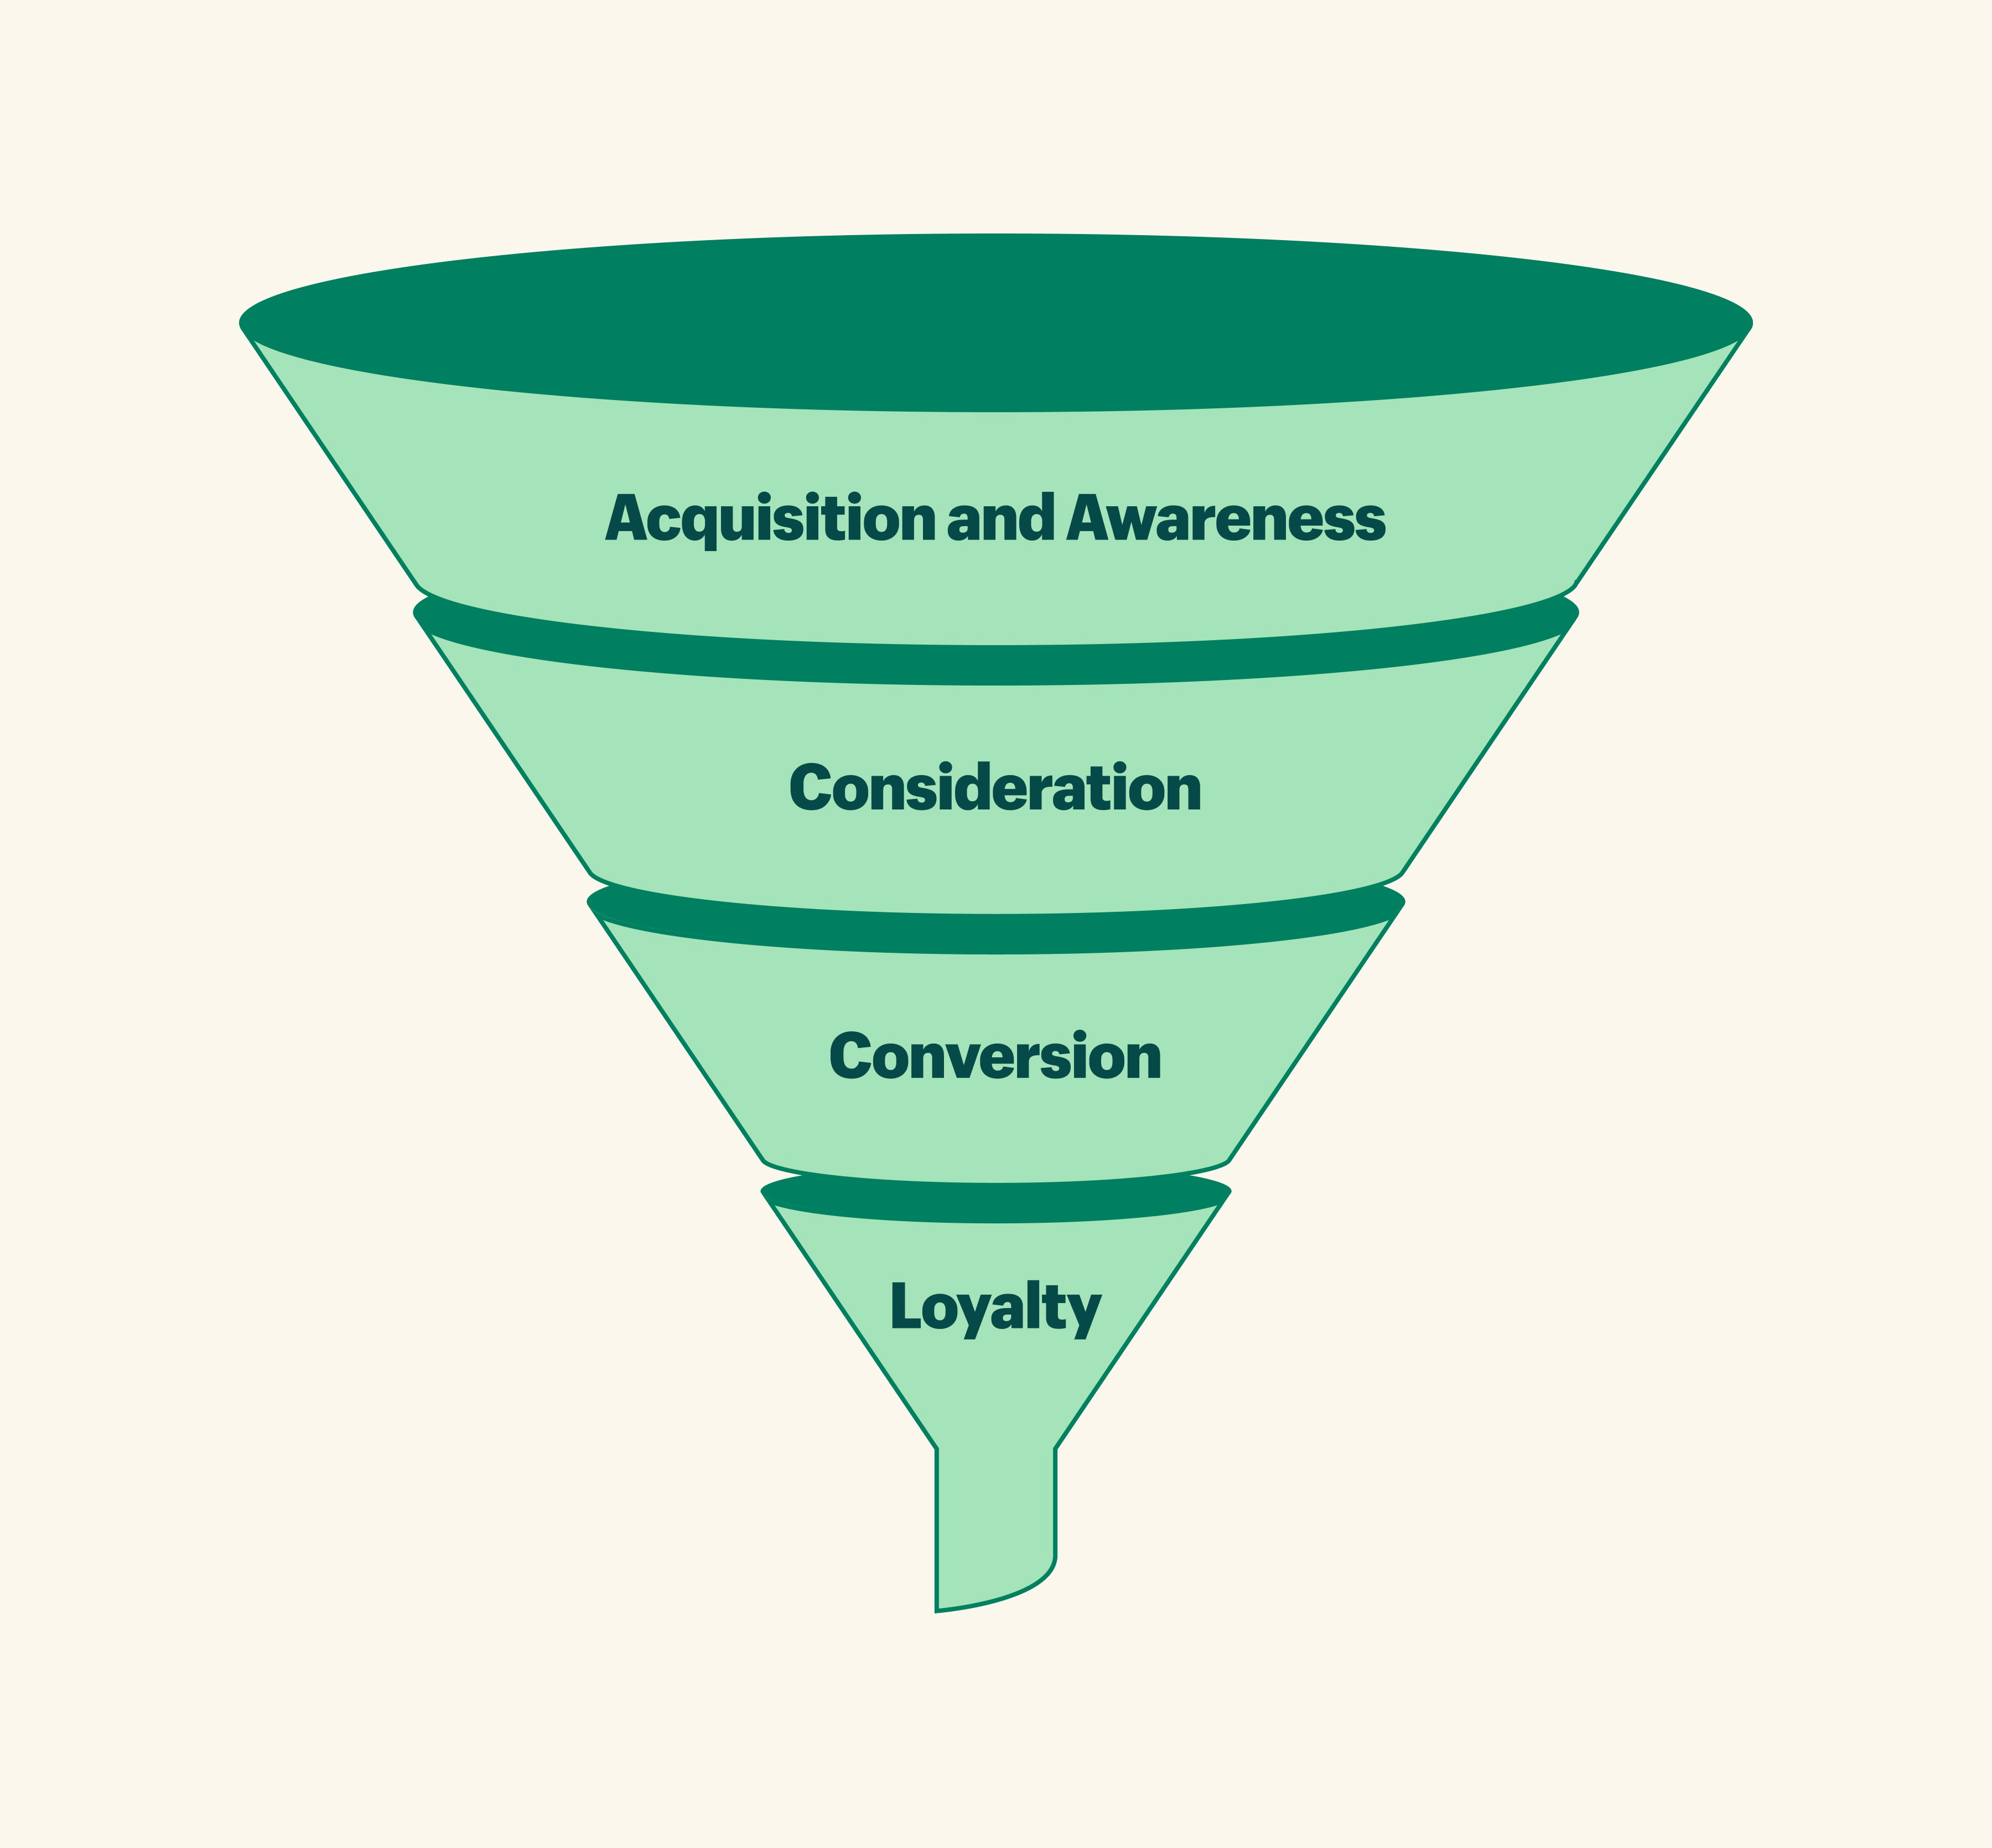
Marketing funnel
Awareness: This is when a prospective customer discovers a brand through digital marketing channels such as targeted online ads or indirect digital marketing channels such as search engine optimization (SEO).
Interest: In this stage, the customer's interest is sufficiently piqued by visiting the company's owned media channels to learn more about their product.
Consideration: This is when a potential customer begins contemplating a product as a solution to their problem.
Action: Here, the customer decides to patronize the company and purchase a product.

Slide 6
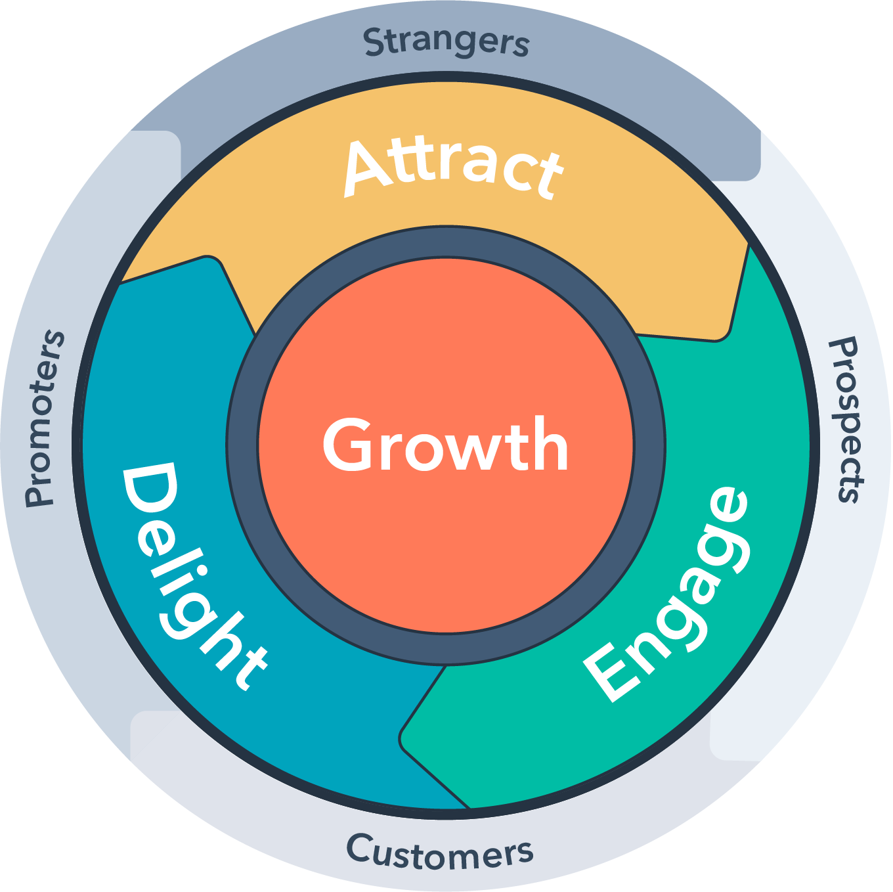
Flywheel model
The flywheel model breaks down the customer journey into three phases:
Attract: Focuses on attracting customers' attention through organic or inorganic digital marketing strategies
Engage: Focuses on creating a relationship with your audience and making them aware of your products
Delight: Focuses on supporting and enabling customers to have positive experiences and meet their needs

Slide 7
Forrester’s 5 i
Involvement: The act of getting the customer involved with the brand or product. Involvement may be quantified through website statistics, such as page views, website traffic, and average time spent on a page.
Interaction: This stage encompasses the customer's activities with your brand or product, such as making a purchase, signing up for a newsletter, and sharing photos.
Intimacy: Intimacy reveals the sentiment and emotions behind the actions customers take with your brand or product. Examples include the sentiments behind a product review, social media mention, or customer testimonials.
Influence: The Influence stage refers to the likelihood that customers and stakeholders outside your organization recommend your products to others. This can be measured via share rate, referrals, and online mentions.
Individual: The Individual implies focusing on a single person rather than a group or community. The 'Individual' is more granular and specific and less generic.

Slide 8
McKinsey's consumer decision journey
Trigger: This is when users realize they have a problem and require a product or service to provide a solution. This trigger starts the consumer decision journey.
Initial consideration set: When contemplating a purchase, people reflect on their first consideration set — the familiar brands that come to mind instantly.
Evaluation: Consumers seek and acquire information from several sources and review websites to discover which brand provides what they want or need.
Buying: The consumer picks a brand and makes a purchase after filtering the alternatives based on information from the Evaluation step.
Ongoing exposure: After buying the product or service, customers develop post-buy expectations that influence their decision-making process for future purchases.
Loyalty loop: Depending on how well the product solves a user's needs, they may become loyal customers and brand advocates, attracting more customers to your business.

Slide 9
Questions?
rajesh.19435@lpu.co.in

